Slide 1

Data Types and Variables
Doncho Minkov
Technical Trainer
http://minkov.it
Telerik Software Academy
http://academy.telerik.com

Slide 2

Table of Contents
Data Types
Integer
Floating-Point
Boolean
String
Declaring and Using Variables
Identifiers
Declaring Variables and Assigning Values

Slide 3


Data Types

Slide 4
How Computing Works?
Computers are machines that process data
Data is stored in the computer memory in variables
Variables have name, data type and value
Example of variable definition and assignment in JavaScript
Variable name
var count = 5;
Variable value

Slide 5

What Is a Data Type?
A data type:
Is a domain of values of similar characteristics
Defines the type of information stored in the computer memory (in a variable)
Examples:
Positive integers: 1, 2, 3, …
Alphabetical characters: a, b, c, …

Slide 6
JavaScript Data Types
JavaScript is actually typeless language
i.e. the type of a variable can be changed
All the variables are declared with var
var count = 5; //variable holding integer value
var name = "Doncho Minkov"; //variable holding a string
var mark = 5.25 //variable holding floating point number

Slide 7

Integer Types

Slide 8
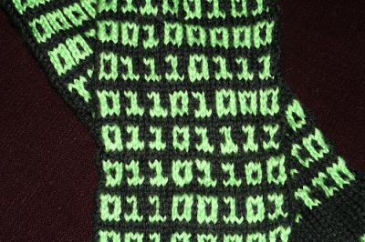
What are Integer Types?
Integer types:
Represent whole numbers
Have range of values, depending on the size of memory used

Slide 9
Integer Types - Example
Integer type can hold numbers from -9007199254740992 to 9007199254740992
var studentsCount = 5;
var maxInteger = 9007199254740992;
var minInteger = -9007199254740992;

Slide 10

Integer Types
Live Demo

Slide 11

Floating-Point

Slide 12
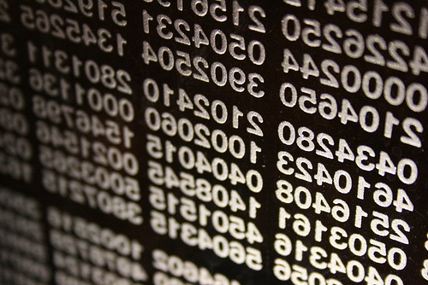
What are Floating-Point Types?
Floating-point types:
Represent real numbers
Have range of values and precision
Can behave abnormally in the calculations

Slide 13
Floating-Point Types
Floating-point size depend on the platform
the browser and the OS
32-bit OS and browser have 32 bits for number, while 64-bit have 64 bits
It is good idea to use up to 32-bit numbers
Will always work on all platforms

Slide 14

Abnormalities in the Floating-Point Calculations
Sometimes abnormalities can be observed when using floating-point numbers
Comparing floating-point numbers can not be performed directly with the == operator
Example:
var a = 1.0;
var b = 0.33;
var sum = 1.33;
var equal = (a+b == sum); // False!!!
console.log("a+b = "+ (a+b) + ", sum = "+ sum + ", sum == a+b? is " + equal);

Slide 15

Floating-Point and Decimal Floating-Point Types
Live Demo

Slide 16
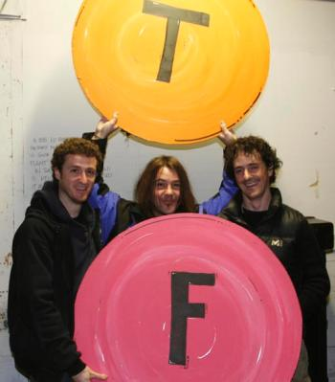
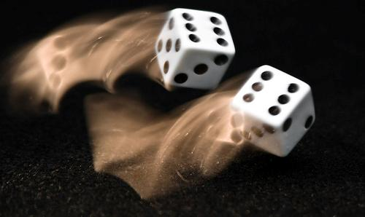
Boolean Type

Slide 17

The Boolean Data Type
The Boolean data type:
Has two possible values:
true and false
Is useful in logical expressions

Slide 18
Boolean Values – Example
Example of boolean variables taking values of true or false:
var a = 1;
var b = 2;
var greaterAB = (a > b);
console.log(greaterAB); // False
var equalA1 = (a == 1);
console.log(equalA1); // True

Slide 19

Boolean Type
Live Demo

Slide 20

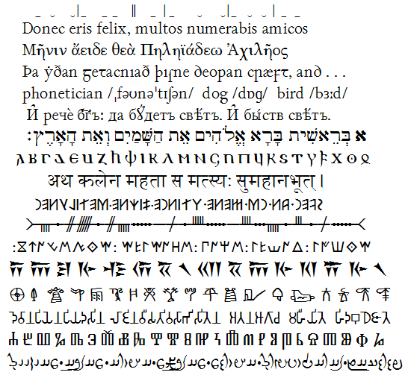
String Type

Slide 21
The String Data Type
The string data type:
Represents a sequence of characters
Strings are enclosed in quotes:
Both ' and " work
Strings can be concatenated
Using the + operator
var s = "Microsoft .NET Framework";

Slide 22
Saying Hello – Example
Concatenating the two names of a person to obtain his full name:
NOTE: a space is missing between the two names! We have to add it manually
var firstname = "Ivan";
var lastname = "Ivanov";
Console.log("Hello, " + firstname + "!");
var fullName = firstname + " " + lastname;
Console.log("Your full name is " + fullname);

Slide 23

String Type
Live Demo

Slide 24
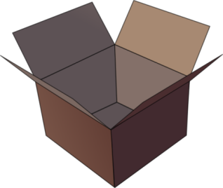

Introducing Variables
p
q
i

Slide 25

What Is a Variable?
A variable is a:
Placeholder of information that can usually be changed at run-time
Variables allow you to:
Store information
Retrieve the stored information
Manipulate the stored information

Slide 26

Variable Characteristics
A variable has:
Name
Type (of stored data)
Value
Example:
Name: counter
Type: integer
Value: 5
var counter = 5;

Slide 27
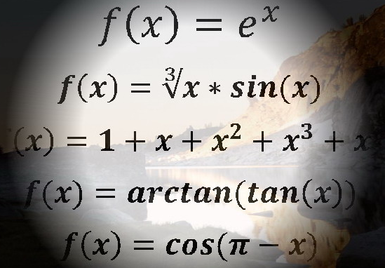
Declaring And Using Variables

Slide 28
Declaring Variables
When declaring a variable we:
Specify its name (called identifier)
May give it an initial value
The type is identified by the value
The syntax is the following:
Example:
var <identifier> [= <initialization>];
var height = 200;

Slide 29
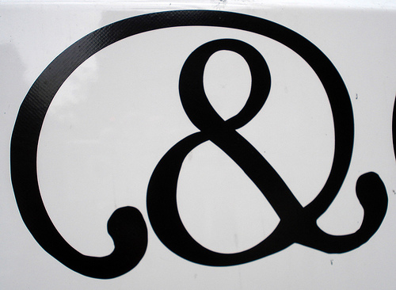
Identifiers
Identifiers may consist of:
Letters (Unicode)
Digits [0-9]
Underscore "_"
Dollar '$'
Identifiers
Can begin only with a letter or an underscore
Cannot be a JavaScript keyword

Slide 30
Identifiers (2)
Identifiers
Should have a descriptive name
It is recommended to use only Latin letters
Should be neither too long nor too short
Note:
In JavaScript small letters are considered different than the capital letters (case sensitivity)

Slide 31
Identifiers – Examples
Examples of correct identifiers:
Examples of incorrect identifiers:
var New = 2; // Here N is capital
var _2Pac; // This identifiers begins with _
var поздрав = "Hello"; // Unicode symbols used
// The following is more appropriate:
var greeting = "Hello";
var n = 100; // Undescriptive
var numberOfClients = 100; // Descriptive
// Overdescriptive identifier:
var numberOfPrivateClientOfTheFirm = 100;
var new; // new is a keyword
var 2Pac; // Cannot begin with a digit

Slide 32
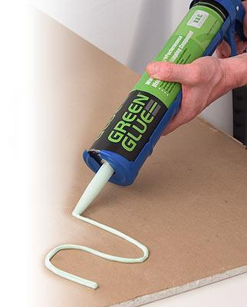

Assigning Values To Variables

Slide 33
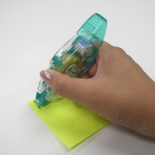
Assigning Values
Assigning of values to variables
Is achieved by the = operator
The = operator has
Variable identifier on the left
Value of the corresponding data type on the right
Could be used in a cascade calling, where assigning is done from right to left

Slide 34
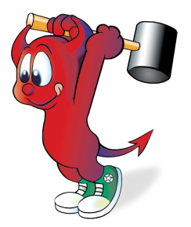
Assigning Values – Examples
Assigning values example:
var firstValue = 5;
var secondValue;
var thirdValue;
// Using an already declared variable:
secondValue = firstValue;
// The following cascade calling assigns
// 3 to firstValue and then firstValue
// to thirdValue, so both variables have
// the value 3 as a result:
thirdValue = firstValue = 3; // Avoid this!

Slide 35
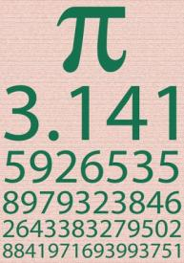
Initializing Variables
Initializing
Is assigning of initial value
Must be done before the variable is used!
Several ways of initializing:
By using a literal expression
By referring to an already initialized variable

Slide 36
Initialization – Examples
Example of some initializations:
// This is how we use a literal expression:
var heightInMeters = 1.74;
// Here we use an already initialized variable:
var greeting = "Hello World!";
var message = greeting;

Slide 37
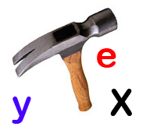

Assigning and Initializing Variables
Live Demo

Slide 38
Data Types and Variables
http://academy.telerik.com

